Slide 1
The Parasite Niche
Unit 2: Organisms and Evolution
Advanced Higher Biology
Miss Aitken

Slide 2
Ecological Niche
In National 5, we learned that a niche is the “role an organism plays in it’s environment”.
However, at Advanced Higher, a more sophisticated definition is required.
To work out the role an organism plays in it’s environment, there are a number of factors that must be considered.

Slide 3
Ecological Niche
The factors that must be considered:
Abiotic factors – non living – temperature, moisture, pH, light intensity etc.
Biotic factors – living – predators, disease, competition, parasitism etc.
The ecological niche is best defined as “the summary of tolerances and requirements of a species.”

Slide 4
Fundamental Niche
The fundamental niche of a species is the set of resources that the organism is capable of using, and living in, without competition from any other species.
Realised Niche
The realised niche of a species is the set of resources that the organism actually uses, and lives in, considering the competition from other species around it.

Slide 5
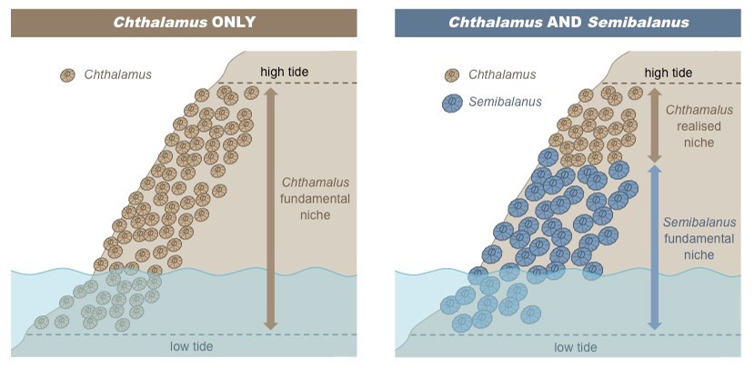

Slide 6
Competitive Exclusion Principle
In some situations, two species with the same realised niche are in direct competition.
During this competition, the weaker of the two species will eventually lose and may be lost from that area (local extinction).
This is known as the competitive exclusion principle.

Slide 7
Competitive Exclusion Principle - Squirrels
Red squirrels and grey squirrels have the same realised niche.
Red squirrels are native to the UK, whereas grey squirrels were introduced from the US and Canada.
Grey squirrels are larger than red squirrels and are able to eat seeds from some types of trees before they are ripe – red squirrels cannot do this, and it has lead to local extinction in some areas.

Slide 8
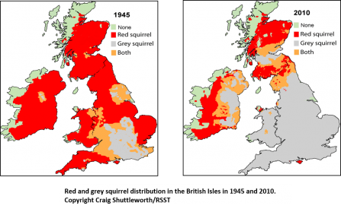

Slide 9
Resource Partitioning
When two species live in a habitat AND have similar requirements, it may be that their realised niches are different enough for them to co-exist peacefully.
In this case, resource partitioning happens, where each species can exploit different components of the resource, reducing competition.

Slide 10
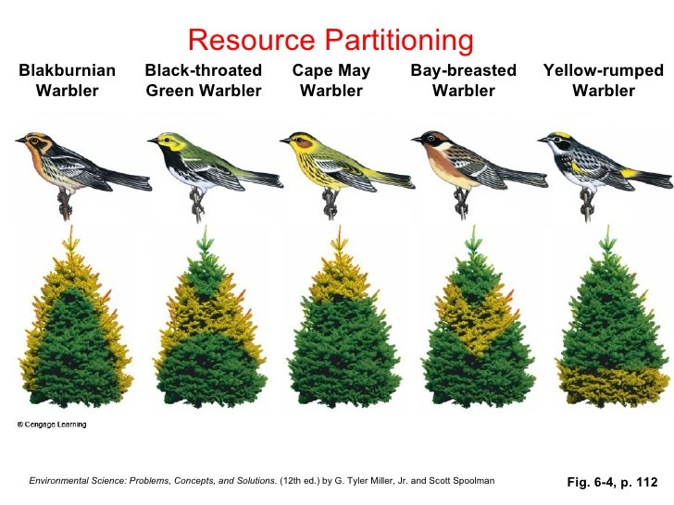

Slide 11
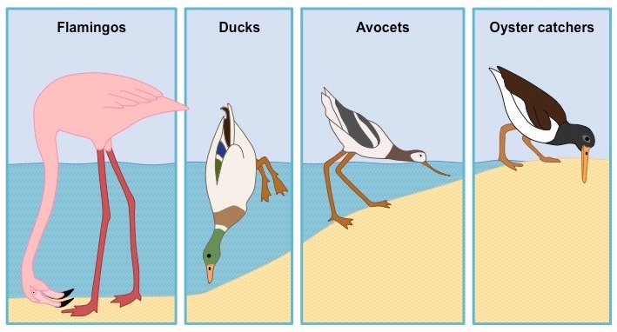

Slide 12
The Niche of Parasites
Symbiosis – association between organisms of different species
Parasites are symbionts that gain nutrients at the expense of the host.
Parasites use the host’s resources to grow and to reproduce.
The host is at a disadvantage – as well as losing resources, it also must defend it’s tissues from parasitic attack.

Slide 13
Parasite Groups
Ectoparasites: Live and feed on the surface of hosts – e.g. ticks, lice, fleas
Endoparasites: Live and feed inside the host – e.g. tapeworm and some types of bacteria and viruses.

Slide 14
Parasite Reproduction
In a parasitic relationship, the parasite can produce many more offspring than the host.
For example, a flea that lives on a cat can produce thousands of offspring in a year.

Slide 15
Co-Evolution as a Parasite
A particular parasite has evolved in response to the evolution of it’s host.
This means that parasites have a very narrow niche and are very host-specific. They would find it very hard to live on a different host.
Example: 3 different types of parasitic louse which live on different areas of the human body.

Slide 16
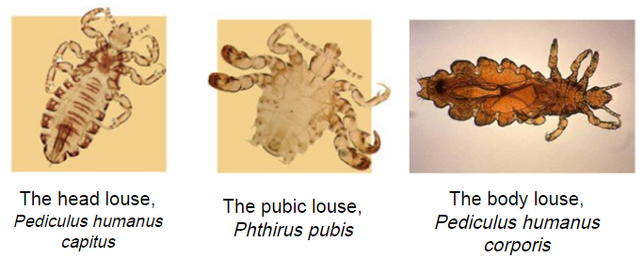

Slide 17
Parasites are Degenerate
Because many of their needs are provided by the host, many parasites are degenerate.
This means they lack the structures and organs that are found in other organisms.
For example, tapeworms live in the human digestive system, surrounded by digested food. This means they no longer require a digestive system.

Slide 18
Parasite Lifecycles
Parasite lifecycles can involve more than one host.
Definitive host: Where the parasite reaches sexual maturity and so can carry out reproduction
Intermediate host: Where the parasite develops
Vector: A species which plays an active part in the transmission of a parasite. Sometimes vectors can also be hosts.

